Slide 1
THE STATE UNIVERSITY OF HUMANITIES AND TECHNOLOGY (GGTU) The City of Orekhovo-Zuyevo, 2024-2025

Slide 2
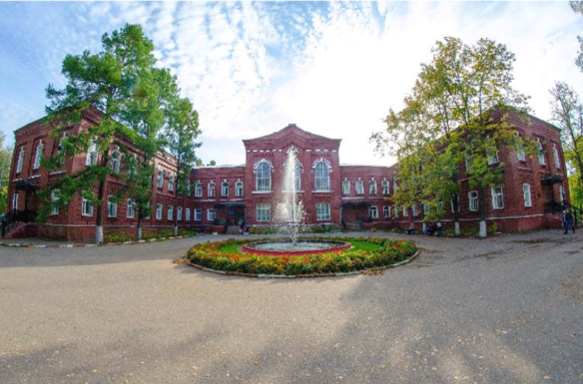
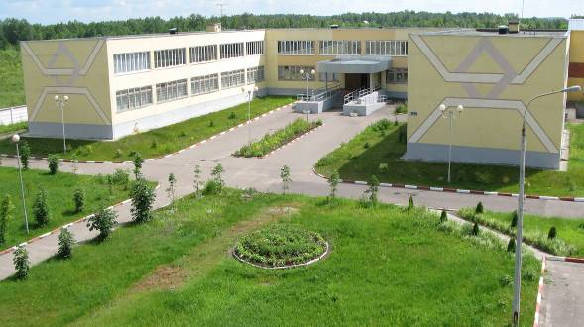
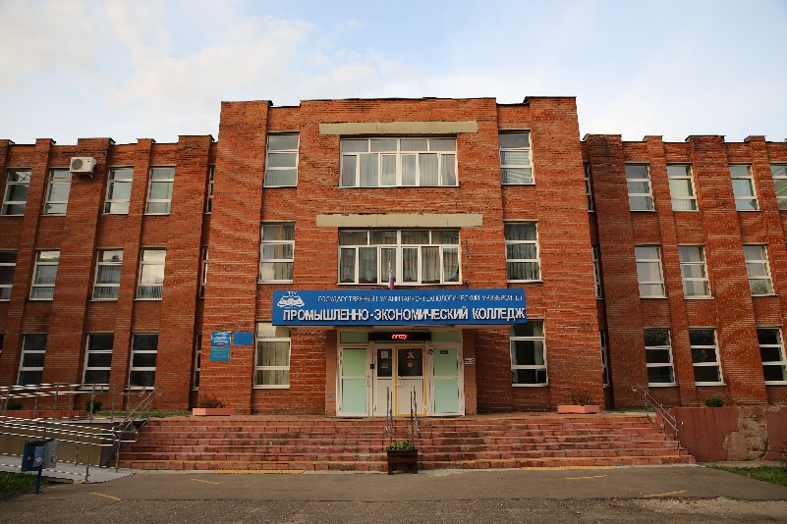
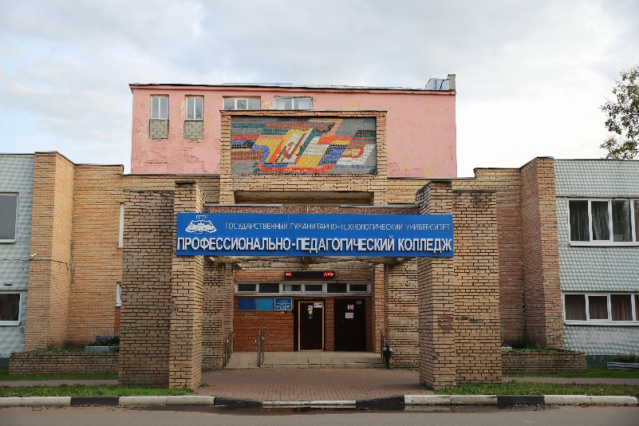
GGTU is an efficient university
GGTU is in ТОP 100 RAEX
The 1st League in the 2023 Efficiency Rating!
THE GGTU COLLEGES are in TOP 100 of the Russian Federation
and in TOP 10 of the Moscow Region

Slide 3
Accreditation
All the Educational Programmes of the Secondary Vocational Education and the Higher Education are accredited
The License on Educational Activities Л035-00115-50/00096806 dated 16.12.2015 No 3790-06
The Certificate of State Accreditation No 3252 series 90А01 No 0003414 dated 02.10.2019

Slide 4
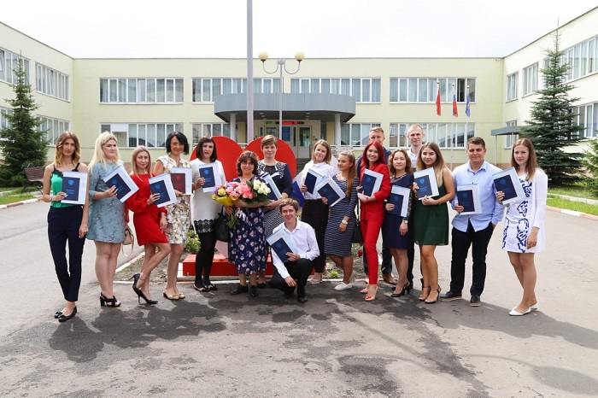
Education in GGTU :
A diploma of the established form
Programmes of various levels
Secondary Vocational Education
Higher Education – Bachelor’s and Master’s Degrees
For non-locals ― accommodation in comfortable dormitories
Interesting and creative student life
High-quality education
Participation in regional, All-Russian and international events
Supplementary Education

Slide 5
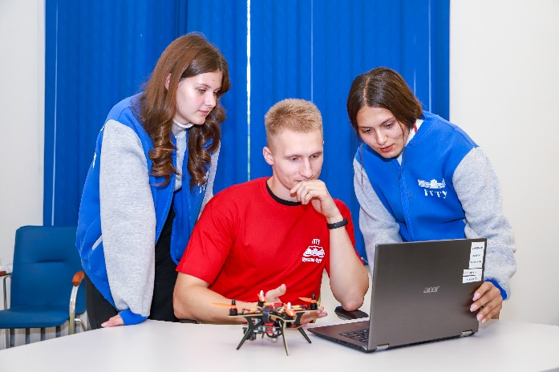
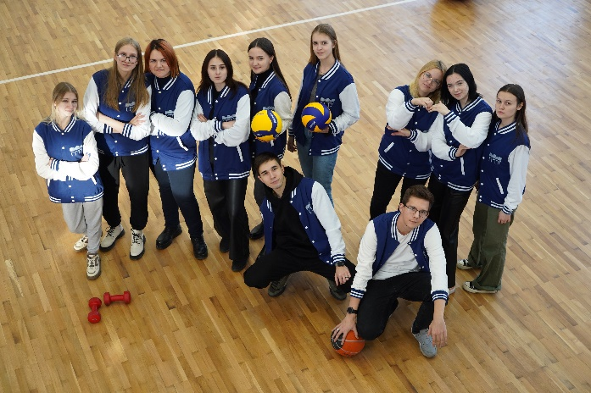
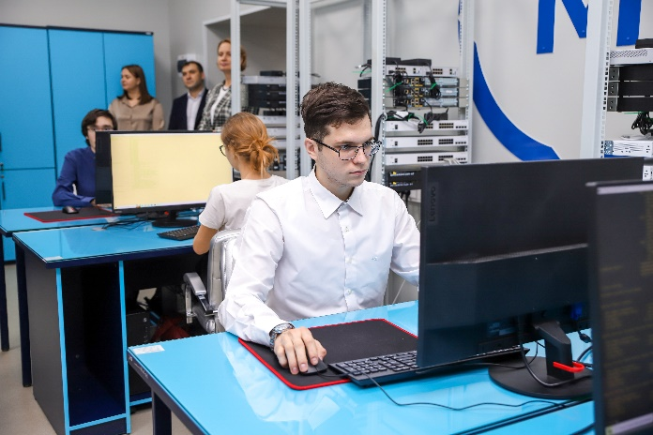
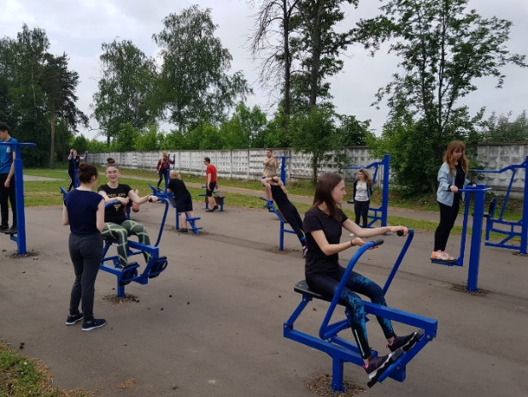
The University Resource Base
15 educational buildings
9 dormitories
5 colleges
Sports halls, sports grounds and fitness rooms, the Sports Complex “The GGTU Sports Point”
Comfortable canteens for students
The Unmanned Robotics Programming Studio “Quadro”

Slide 6
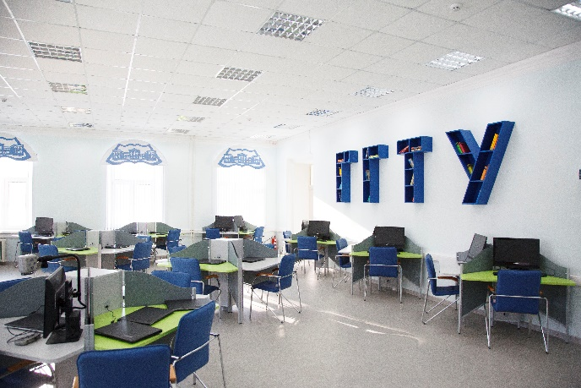
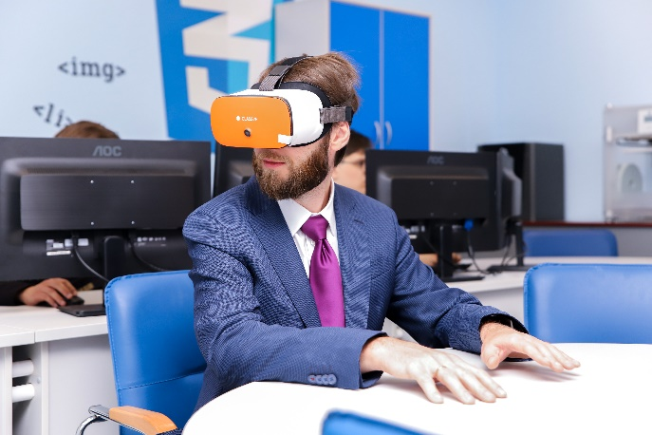
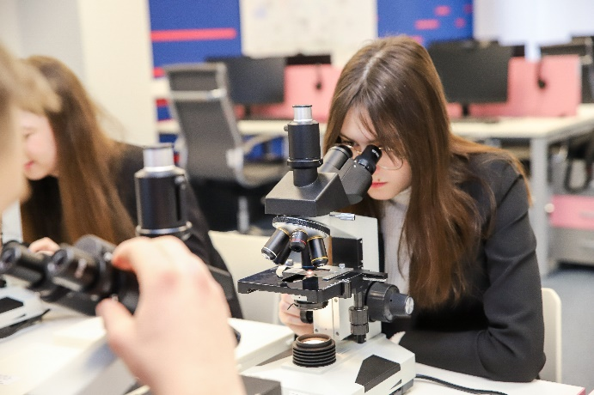
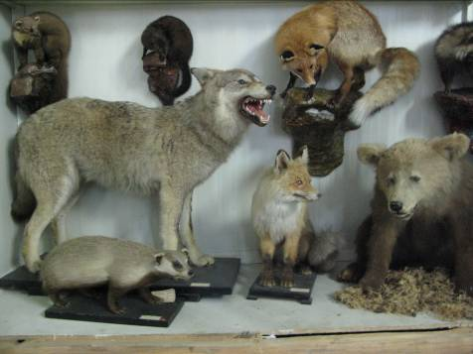
The University Resource Base
The Laboratory of Biotechnologies
The Laboratory of Pre-School Education
The Laboratory of STEAM-Education
The Multimedia Digital Laboratory “University 5.0”
The Multifunctional Digital Video Laboratory
Reading Halls
The Zoological Museum
The Agrobiological Station

Slide 7
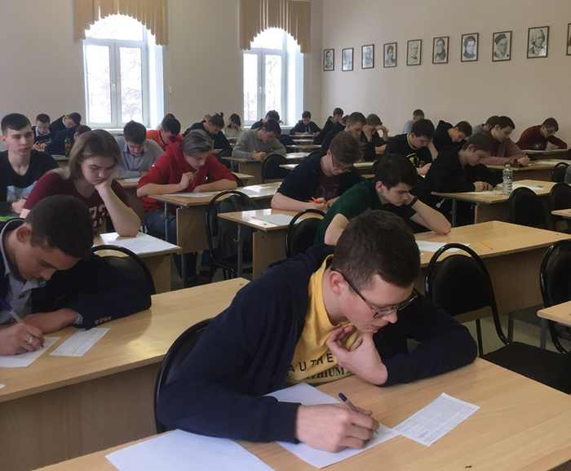
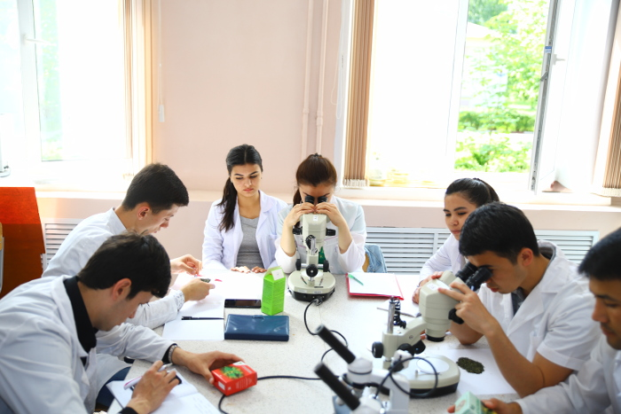
The University Faculties
Faculty of Biology and Chemistry
Faculty of Pre-School Education
Faculty of Foreign Languages
Faculty of Informatics
Historical Faculty
Faculty of Primary School Education
Psychological and Pedagogical Faculty
Faculty of Social Pedagogy
Social and Economic Faculty
Pharmaceutical Faculty
Faculty of Mathematics and Physics
Philological Faculty
Faculty of Law
Department of Physical Education

Slide 8
The Bachelor’s Programmes
Profile of Education | Form of Education | Period of Education | Entrance Tests
44.03.01 Pedagogical Education
Foreign Language (English/German/ French) | Full-time | 4 years | Russian Language | Social Science | Foreign Language
Pre-School Education | Extramural | 5 years |  |  | Mathematics, the Specialized Level
Primary School Education | Extramural | 5 years |  |  | Mathematics, the Specialized Level
History | Extramural | 5 years |  |  | History
Physical Education | Extramural | 5 years
 |  |  |  |  | Biology

Slide 9
The Bachelor’s Programmes
Profile of Education | Form of Education | Period of Education | Entrance Tests
44.03.05 Pedagogical Education (with two Profiles of Education)
Biology, Chemistry | Full-time | 5 years | Russian Language | Social Science | Biology / Chemistry
Mathematics, Informatics | Full-time | 5 years |  |  | Mathematics, the Specialized Level / Informatics and ICT
Mathematics, Physics | Full-time | 5 years |  |  | Mathematics, the Specialized Level / Physics
Primary School Education, Pre-School Education | Full-time | 5 years |  |  | Mathematics, the Specialized Level
Pre-School Education, Supplementary Education | Full-time | 5 years |  |  | Mathematics, the Specialized Level / Biology / Literature

Slide 10
The Bachelor’s Programmes
Profile of Education | Form of Education | Period of Education | Entrance Tests
44.03.05 Pedagogical Education (with two Profiles of Education)
Foreign Language (English), Foreign Language (German/ French) | Full-time | 5 years | Russian Language | Social Science | English Language
Russian Language, English Language | Full-time | 5 years |  |  | English Language
Russian Language, Literature | Full-time | 5 years |  |  | Literature
Russian Language, Literature | Extramural | 6 years |  |  | Literature
History, Social Science | Full-time | 5 years |  |  | History

Slide 11
The Bachelor’s Programmes
Profile of Education | Form of Education | Period of Education | Entrance Tests
44.03.02 Psychological and Pedagogical Education
Psychology of Education | Full-time | 4 years | Russian Language | Biology | Social Science / Mathematics, the Specialized Level
Psychology and Social Pedagogy | Full-time | 4 years |  |  | Social Science / Mathematics, the Specialized Level
Psychology and Social Pedagogy | Extramural | 5 years |  |  | Social Science / Mathematics, the Specialized Level

Slide 12
The Bachelor’s Programmes
Profile of Education | Form of Education | Period of Education | Entrance Tests
44.03.03 Special (Defectological) Education
Speech Therapy | Full-time | 4 years | Russian Language | Biology | Social Science / Mathematics, the Specialized Level
Speech Therapy | Extramural | 5 years |  |  | Social Science / Mathematics, the Specialized Level

Slide 13
The Bachelor’s Programmes
Profile of Education | Form of Education | Period of Education | Entrance Tests
40.03.01 Jurisprudence (Civil Law) | Full-time | 4 years | Russian Language | Social Science | History
40.03.01 Jurisprudence (Criminal Law) | Full-time | 4 years
33.05.01 Pharmacy | Full-time | 5 years
 |  |  |  | Chemistry | Biology
44.03.02 Psychological and Pedagogical Education (Psychology and Social Pedagogy) | Extramural | 5 years |  | Biology | Social Science/ Mathematics, the Specialized Level

Slide 14
The Bachelor’s Programmes
Profile of Education | Form of Education | Period of Education | Entrance Tests
38.03.04 State and Municipal Government (Government of Socio-Economic Systems) | Part-time | 5 years | Russian Language | Social Science | Mathematics, the Specialized Level
38.03.02 Management (Management of Organization) | Part-time | 5 years |  | Mathematics, the Specialized Level | Social Science
09.03.03 Applied Informatics (Applied Informatics in Economy) | Part-time | 4 years 6 months |  | Mathematics, the Specialized Level | Informatics and ICT

Slide 15
Basic Dates of Admission
From June, the 20th to July, the 9th
From September, the 2nd to September, the 7th
1.
— Submitting Applications for Admission
From July, the 10th to July, the 24th
From September, the 9th to September, the 14th
2.
— Entrance Tests
August, the 13th
September, the 23rd
3.
— Enrollment

Slide 16
List of Documents
Personal Identification Document (passport, ID card etc.)
Document about Education
Each document in a foreign language must be submitted together with its notarized translation into the Russian Language
Documents about Education must be legalized (Apostillization or Consular Legalization) depending on the country that issued them

Slide 17
How to Submit Documents ?
Personally at the Admission Board
The City of Orekhovo-Zuyevo, Zelenaya Street, 22, Building 2, Rooms 5 and 6
By Post 142611, the Moscow Region, Orekhovo-Zuyevo, Zelenaya Street, 22, the Admisssion Board
Applicant’s Personal Account on the official website ggtu.ru
Superservice «University Admission Online» The All-Russian Service of Online Documents
Submission via Gosuslugi

Slide 18
Contact Information
The University Website: www.ggtu.ru
The Admission Board: + 7 (499) 955-25-20 (additional numbers 128 or 158), e-mail: pk@ggtu.ru
Migration Support:
+ 7 (499) 955 25 20 (additional number 276); +7(916) 230 53 05, e-mail: inter@ggtu.ru
The Professional Orientation and Employment Department:
Akhmatova Elena Dmitriyevna +7 916 069 63 06, e-mail: perspektiva@ggtu.ru

